Slide 1

BUS BOOKING AND MANAGEMENT SYSTEM
Presented & Created By Coding Crew

Slide 2
Coding Crew Members
Prabhanshu Singh
Aastha Gupta
Vishnu Paswan
21BTCSEAI0047
21BTCSE0164
21BTCSE0255

Slide 3
Overview
The Bus Booking and Management System is an advanced backend solution aimed at simplifying and automating various facets of bus operations, reservations, and passenger interactions. Catering to both bus operators (administrators) and passengers (customers), this system offers a streamlined approach to:
Real-time bus status view
Seamless seat booking and ticket downloading
Efficient schedule management
This robust system leverages Java and CSV file handling to ensure reliability and efficiency in managing bus operations.

Slide 4
BENEFITS
Enhanced Efficiency
Streamlines bus operations with automated processes, reducing manual workload and minimizing errors.
Real-Time Updates
Provides passengers with up-to-date information on bus availability and seat occupancy, improving the booking experience.
Data-Driven Insights
Utilizes CSV files for data storage, enabling easy access to historical data and facilitating data analysis for informed decision-making.
Driving efficiency and reliability in bus operations management

Slide 5
Technology Applied
Core Java
Utilizes Java's object-oriented programming capabilities for robust and maintainable code structure.
Uses exception handling to ensure reliable and error-free program execution.
File Handling
Stores and manages data using CSV files for simplicity and ease of access.
Implements read and write operations for data persistence.
Console I/O
Interacts with users through a command-line interface, ensuring quick and direct user inputs.
Uses Java's I/O classes to read input from the console and write output to the console.
Leveraging proven technologies for a powerful and efficient backend system.

Slide 6
Functioning
Dynamic Bus View
User Feedback Integration
Downloaded Ticket
Ticket Booking and Downloading
Real-Time Seat View
User Feedback View

Slide 7
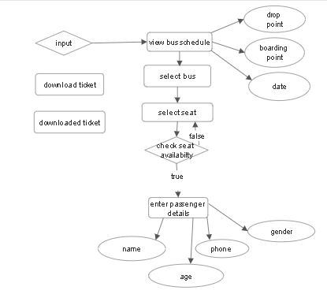
Flow Chart
Functioning 1 &2

Slide 8
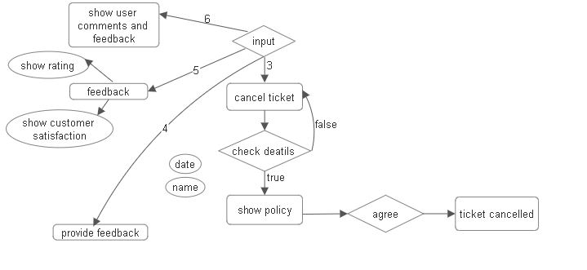
Flow Chart
Functioning 3,4 & 5

Slide 9
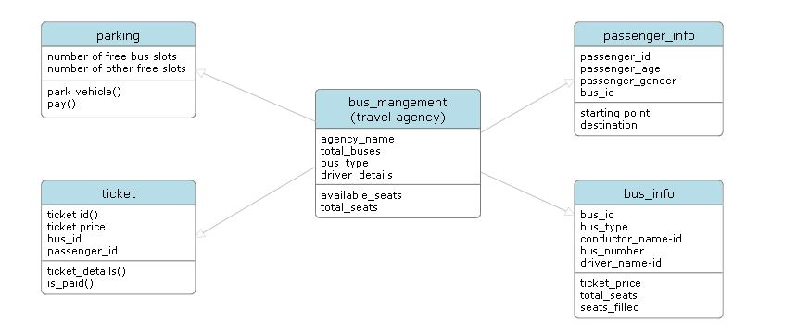
Class Diagram

Slide 10
Module
Key Features and Functionalities
Real-time seat availability checking
Seat selection and reservation
Generation and download of booking confirmations and PDF tickets
Handling of booking modifications and cancellations
Collection of passenger feedback
Passenger Booking and Management
The Passenger Booking and Management Module oversees the complete lifecycle of a passenger's journey, including seat reservation, ticket generation and download, booking cancellation, and feedback collection.

Slide 11
Outputs:
Booking confirmation, downloadable PDF ticket, updated seat availability status, booking cancellation confirmation, feedback acknowledgment
Input and Output
Workflow & Processes
Seat Selection
Booking Confirmation
Ticket Generation
Cancellation
Feedback
Passenger Rating
Inputs:
User-selected bus and seats, passenger details (name, contact information, etc.), feedback comments

Slide 12
Error Handling
Manages errors such as seat double-booking, invalid passenger details, and feedback submission issues
Provides user-friendly error messages and instructions for corrective actions
User Interface
Offers a console interface for selecting seats, providing passenger details, completing bookings, downloading tickets, and submitting feedback
Displays real-time seat availability, booking status, and feedback forms
Additional Features
Authenticated user feedback and rating input and display to all users.
Cancellation Policy based on departure of the bus timing and cancellation time.

Slide 13
Sample Input and Outputs

Slide 14
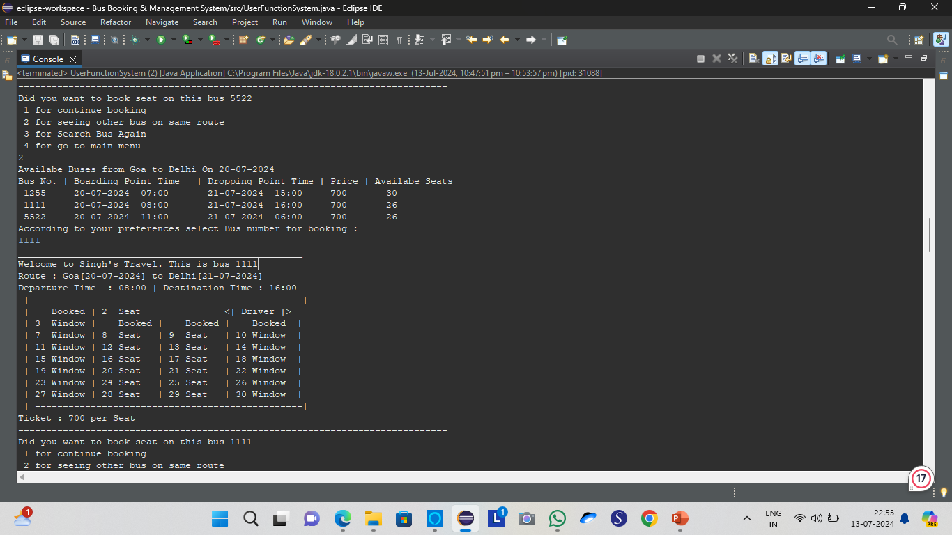
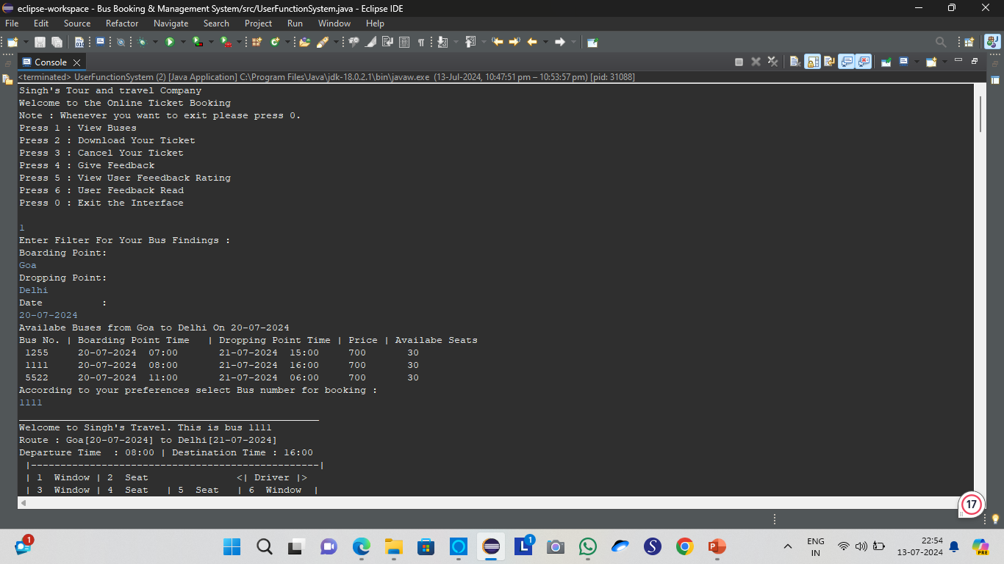
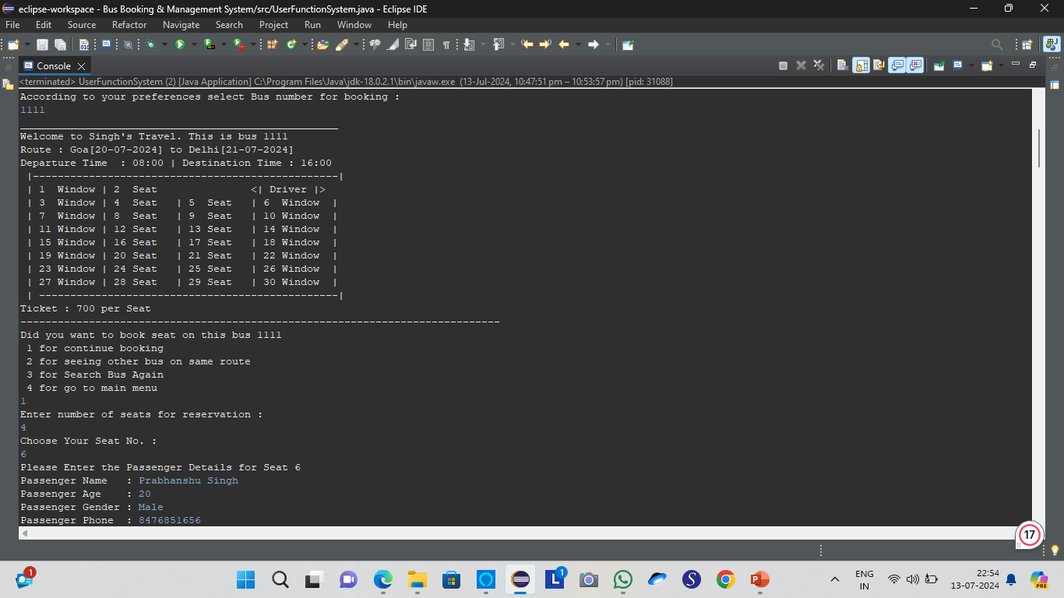
Seat View and Booking

Slide 15
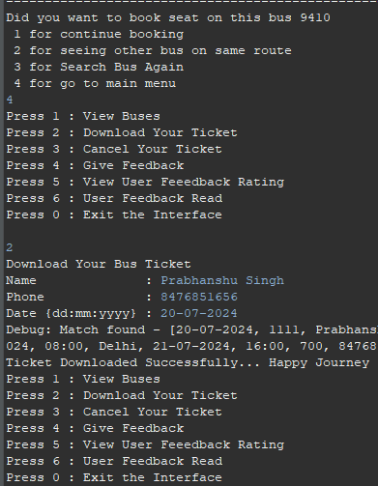
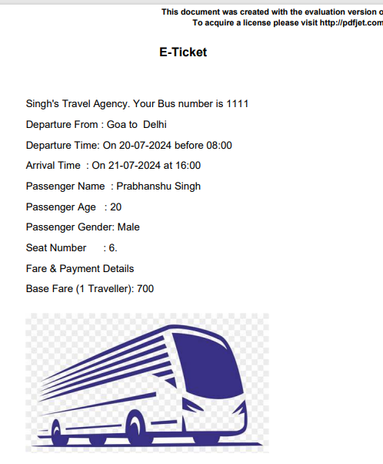
Passenger Ticket Downloading Process

Slide 16
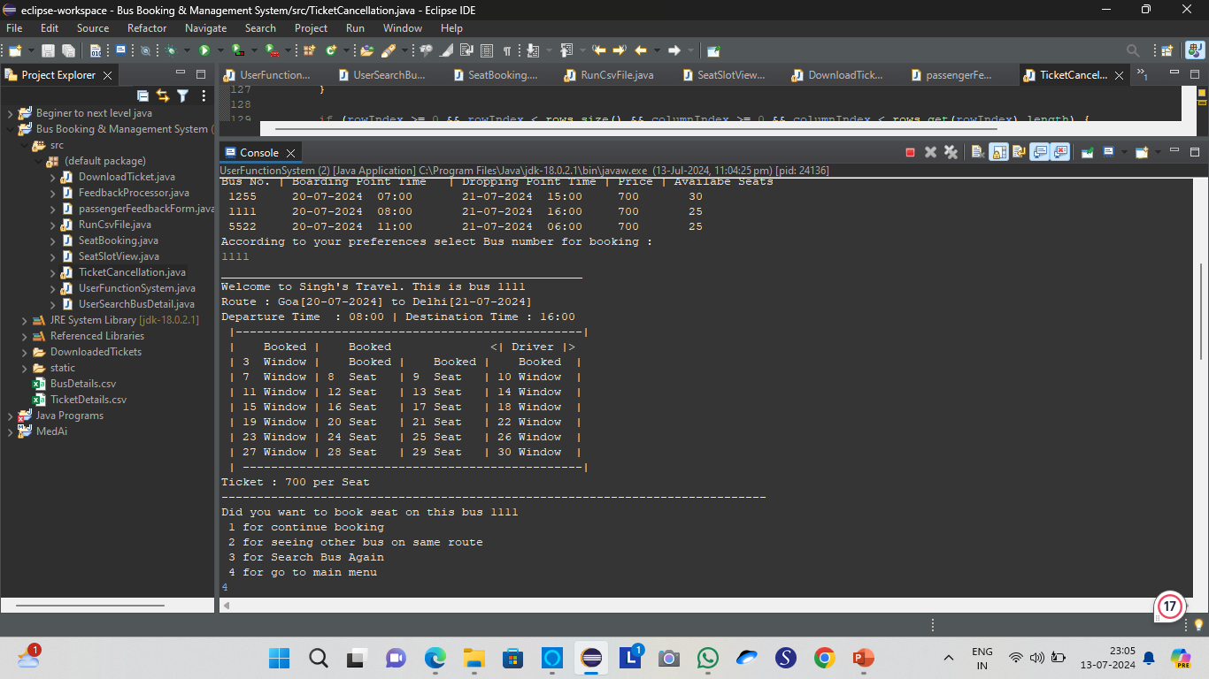
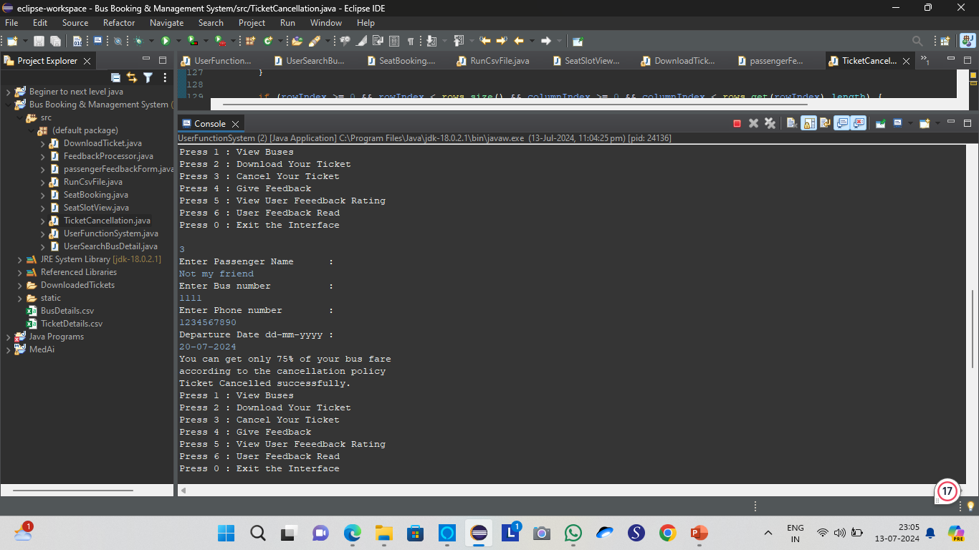
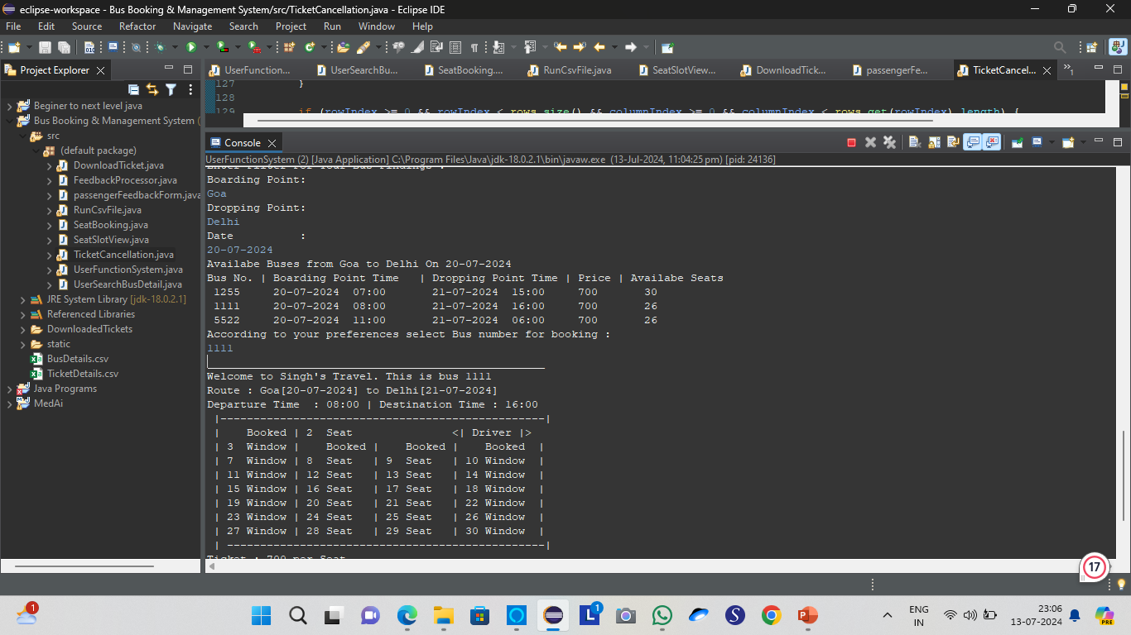
Cancellation Of The Ticket

Slide 17
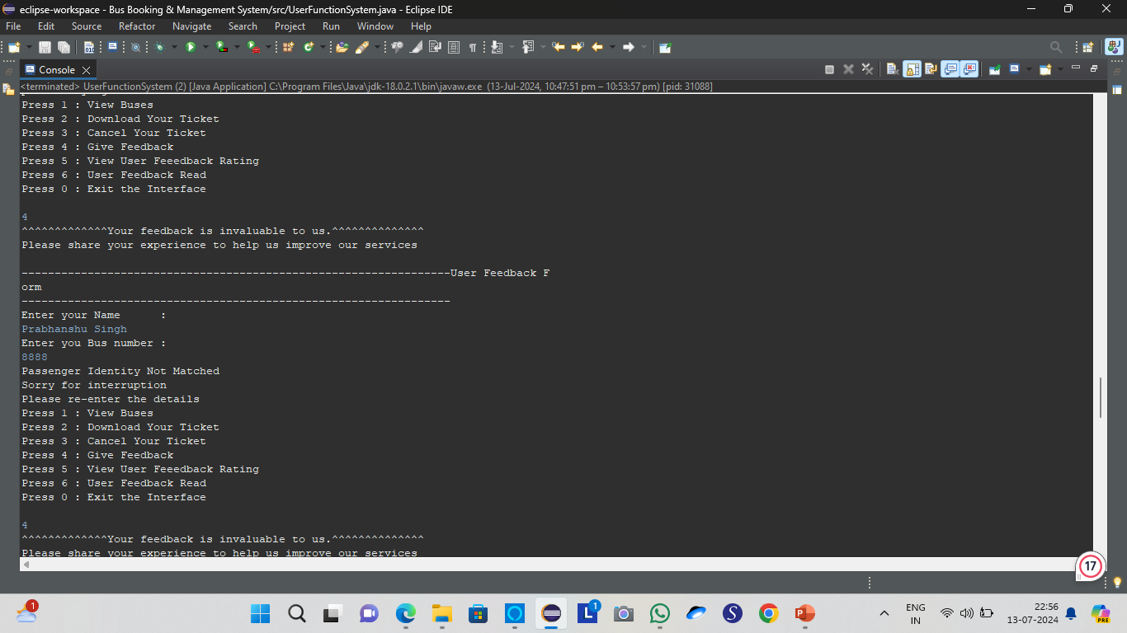
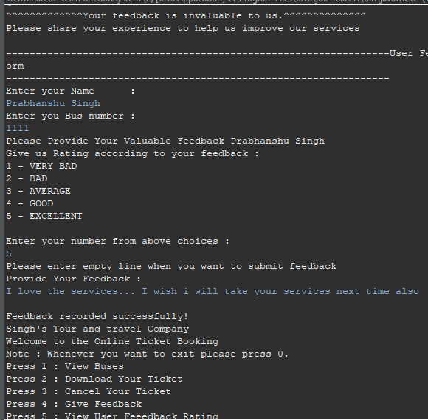
Passenger Feedback Integration
Validate Real User
Validating a passenger is crucial for ensuring the authenticity and reliability of reviews.

Slide 18
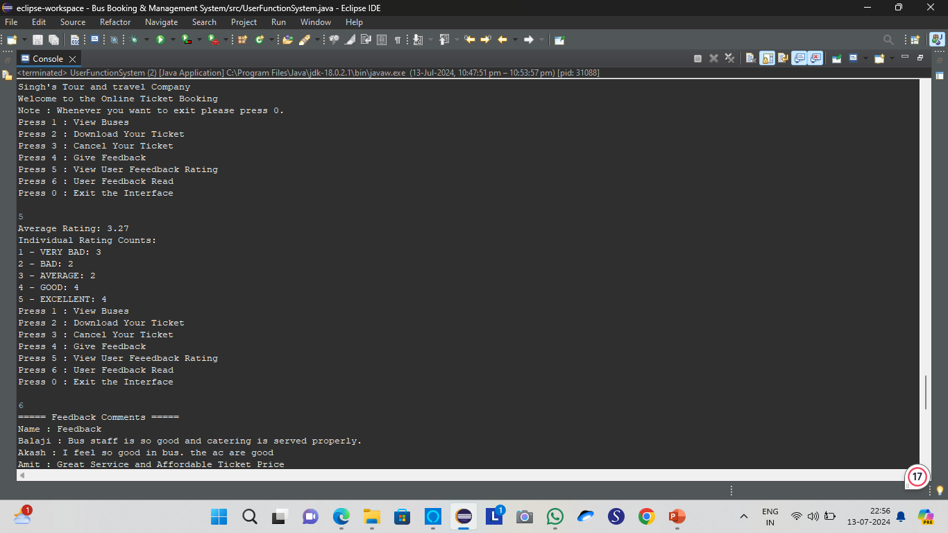
Passenger Rating Review Integration
User Feedback: Allowing users to rate services or products provides valuable feedback that helps improve offerings based on customer preferences and satisfaction.
Why it is required
Enhanced User Experience: Integrating rating views enhances user engagement by enabling them to share their experiences, influencing others' decisions and fostering a sense of community feedback.

Slide 19
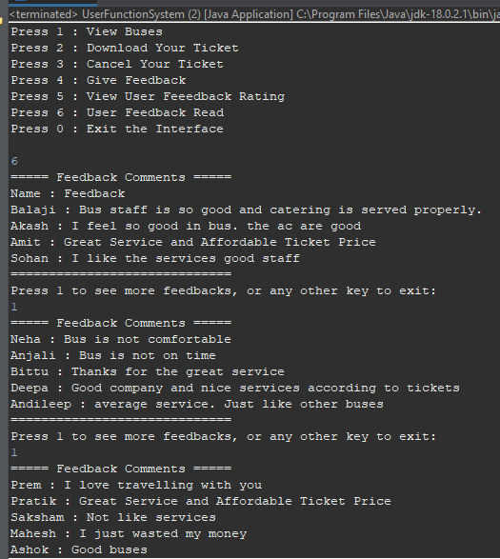
Passenger Feedback Review Integration
Service Improvement: Passenger reviews provide direct insights into their experiences, helping identify areas for improvement such as service quality, cleanliness, and amenities. This feedback loop enables operators to address concerns promptly, enhancing overall customer satisfaction.
Why it is required
Trust and Transparency: By showcasing passenger reviews, the platform builds trust among potential travelers, offering transparency about the service quality and reliability. Positive reviews can also attract new customers by demonstrating the positive experiences of past passengers.

Slide 20
Future Implementation and Features
Pink Seat
Designate specific seats as "Pink Seats" to be reserved exclusively for female passengers, enhancing their safety and comfort during travel.
Graphical User Interface (GUI)
Develop a user-friendly and visually appealing graphical user interface to improve the overall user experience, making the booking process intuitive and efficient.
Payment Gateway Integration
Incorporate a secure payment gateway to facilitate seamless and safe online transactions, offering multiple payment options like credit/debit cards, net banking, and digital wallets.
Loyalty Program for Frequent Travelers
Introduce a loyalty program where frequent travelers can earn points for each journey, redeemable for discounts or free rides, encouraging customer retention and repeat bookings.

Slide 21
References
Bandhan, R. (2018). BUS MANAGEMENT SYSTEM. International Journal of Advanced Research in Computer Science, 9(3), 4–6. https://doi.org/10.26483/ijarcs.v9i3.5821
Grzelak, M., Napierała, Ł., Napierała, Ł., Karovič, V., & Ivanochko, I. (2019). Bus Ticket Reservation System Agile Methods of Projects Management. Advances in Intelligent Networking and Collaborative Systems, 492–501. https://doi.org/10.1007/978-3-030-29035-1_48
Kazi S., Bagasrawala, M., Shaikh, F., & Sayyed, A. (2018). Smart E-Ticketing System for Public Transport Bus. 2018 International Conference on Smart City and Emerging Technology (ICSCET). https://doi.org/10.1109/icscet.2018.8537302
S.SUTHAN, & A.MAHESH M.E. (2023). Bus Ticket Reservation And Seat Allocation System Using Blockchain Technology. International Journal for Multidisciplinary Research, 5(5). https://doi.org/10.36948/ijfmr.2023.v05i05.7270

Slide 22
The End… ThankYou

